Slide 1
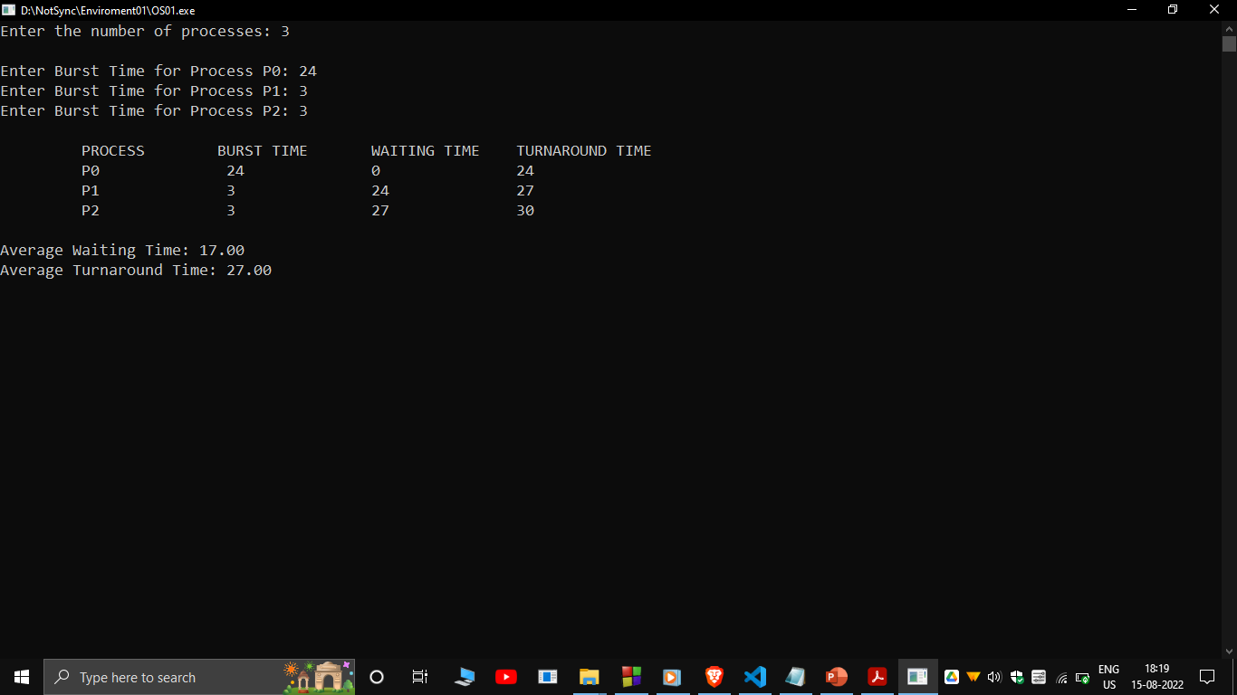
Experiment 01
CPU Scheduling Algorithms – First Come First Serve

Slide 2
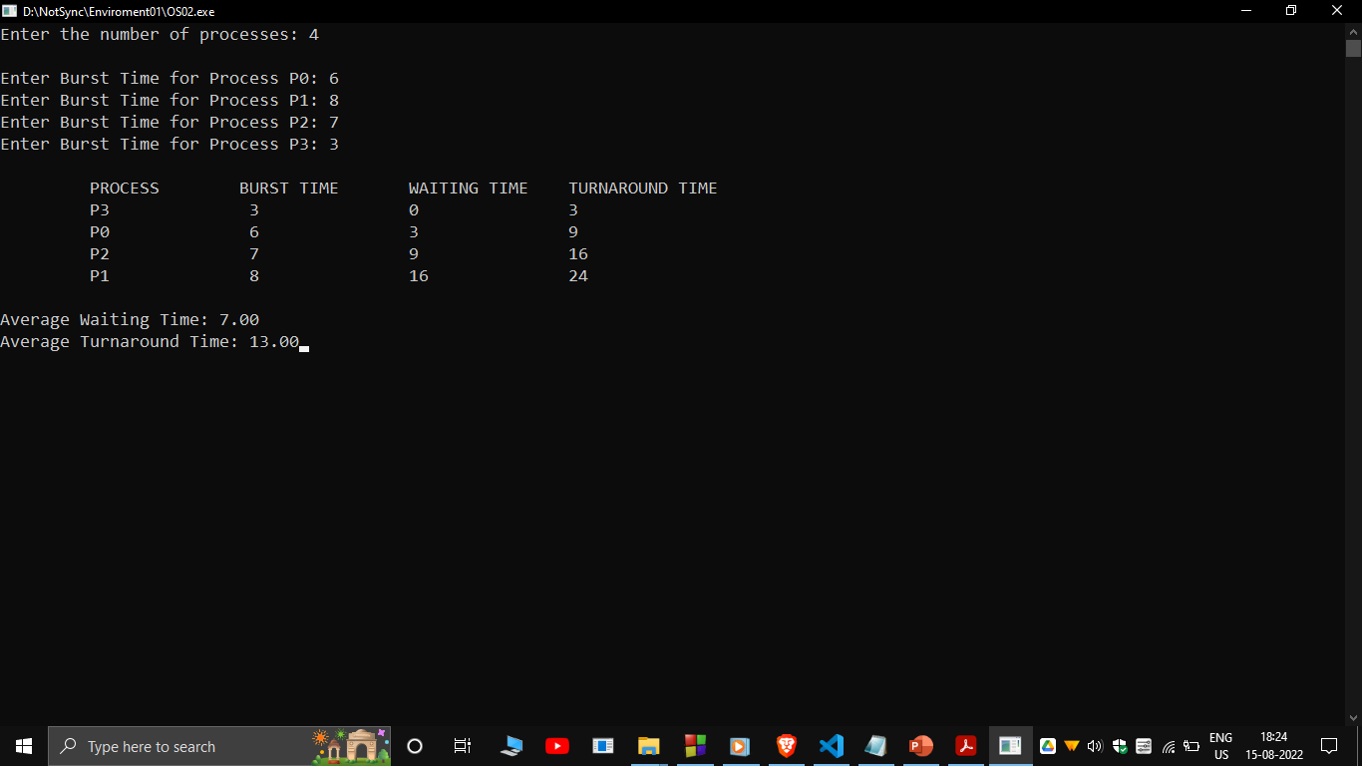
Experiment 02
CPU Scheduling Algorithms – Shortest Job First

Slide 3
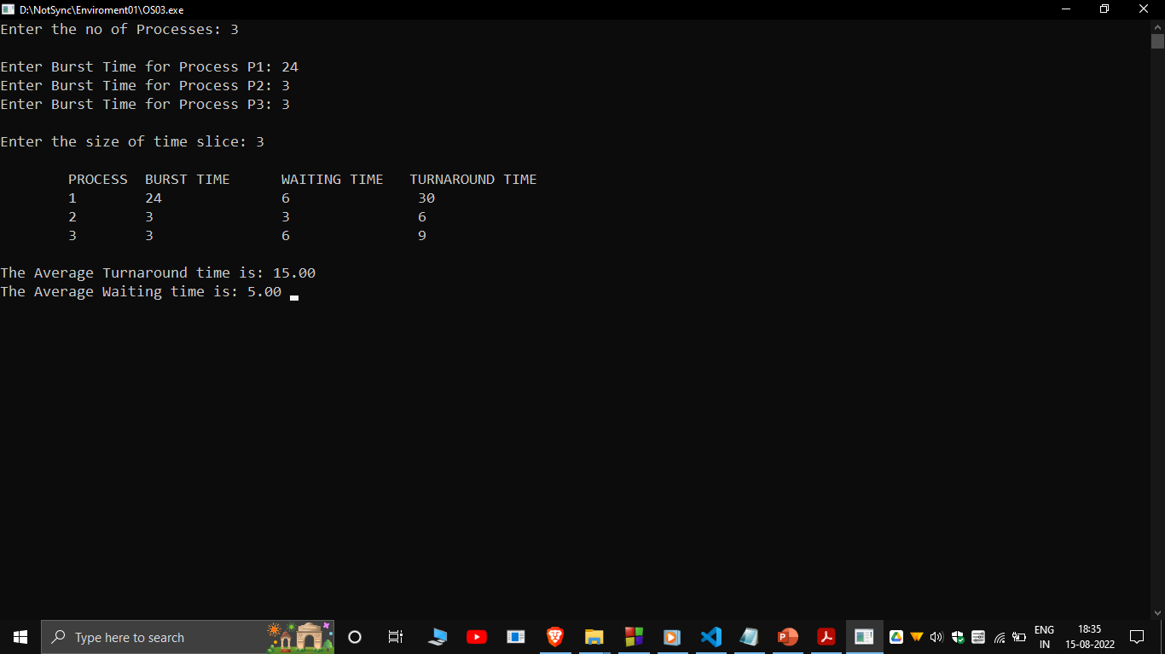
Experiment 03
CPU Scheduling Algorithms – Round Robin

Slide 4
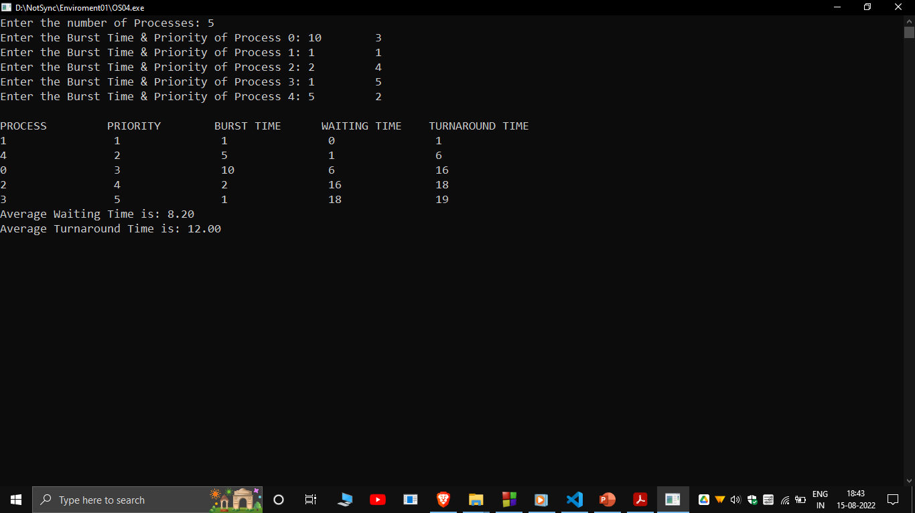
Experiment 04
CPU Scheduling Algorithms – Priority

Slide 5
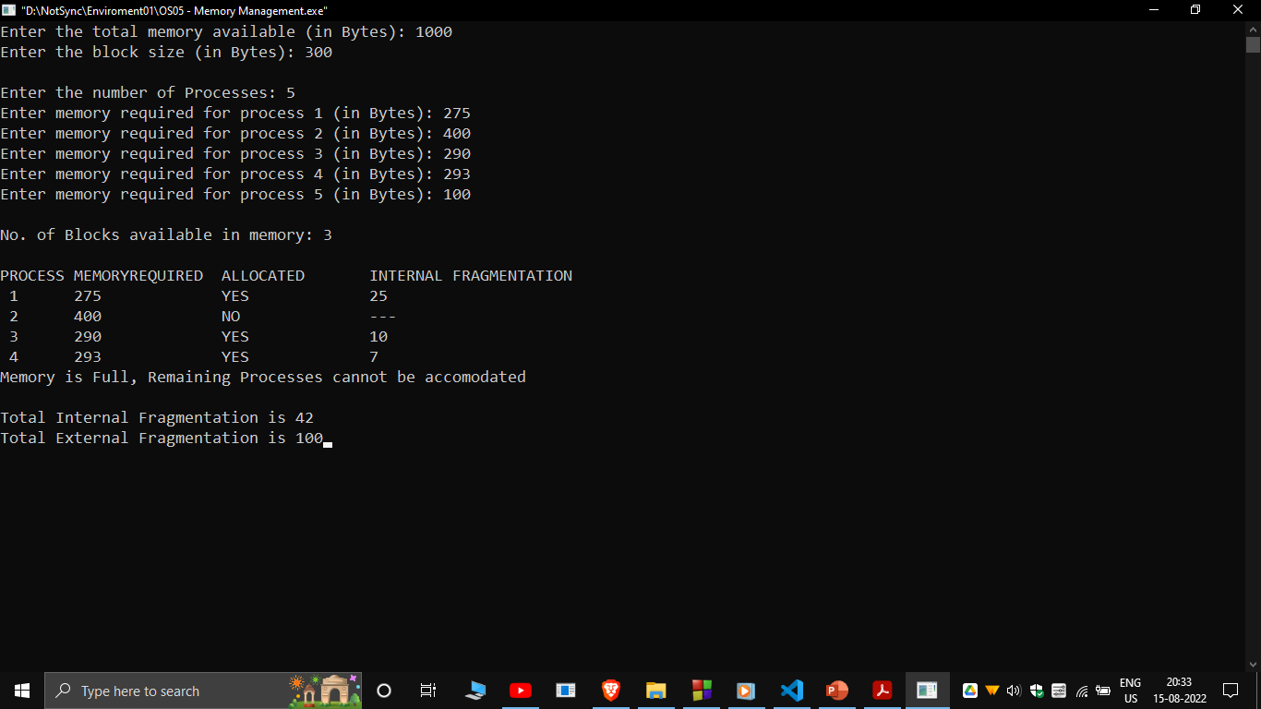
Experiment 05
Memory Management with Fixed Partitioning Technique (MFT)

Slide 6
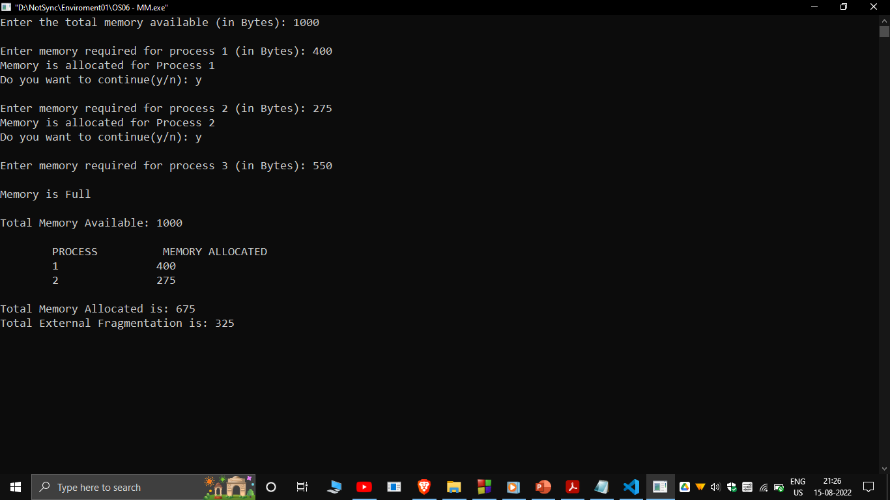
Experiment 06
Memory Management – Memory Variable Partioning Type (MVT)

Slide 7
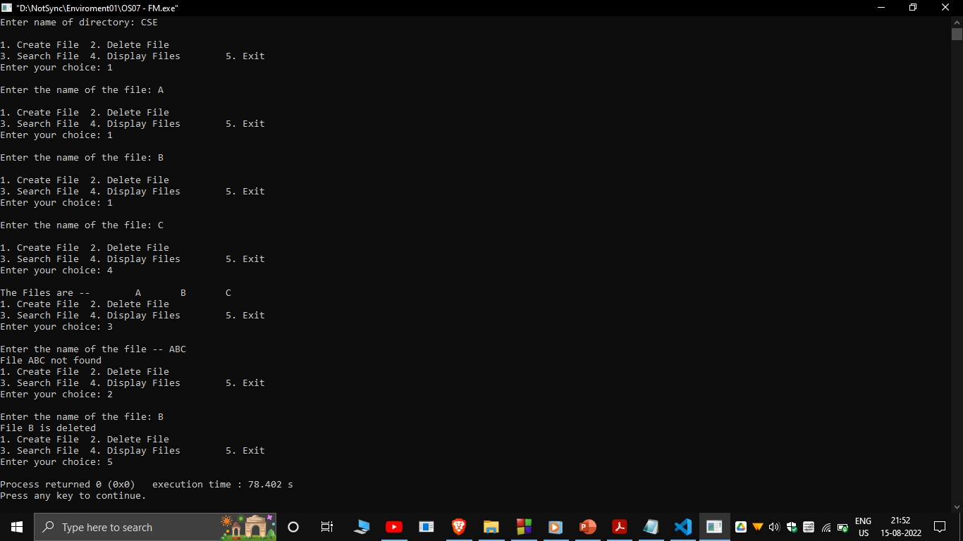
Experiment 07
File Organization Techniques – Single Level Directory

Slide 8
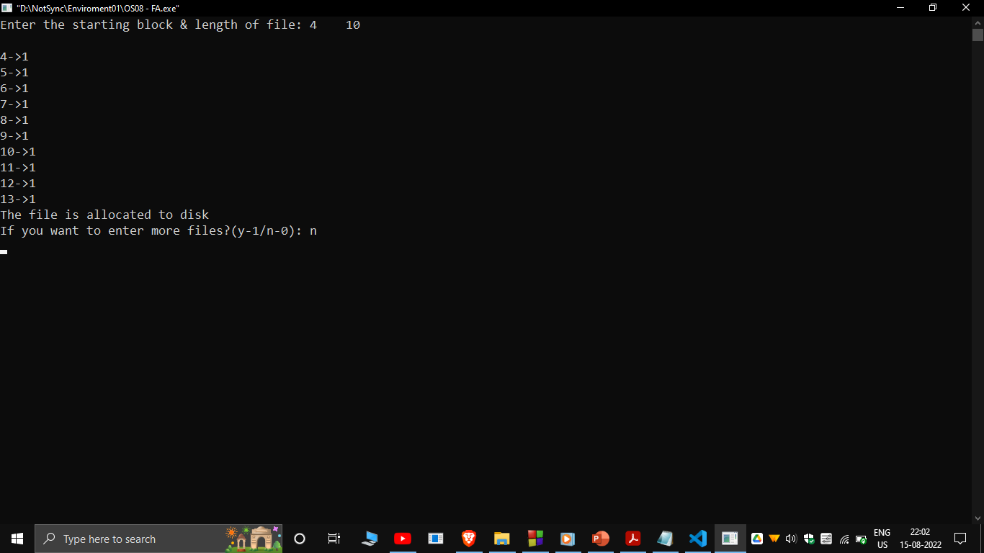
Experiment 08
File Allocation Strategies – Sequential

Slide 9
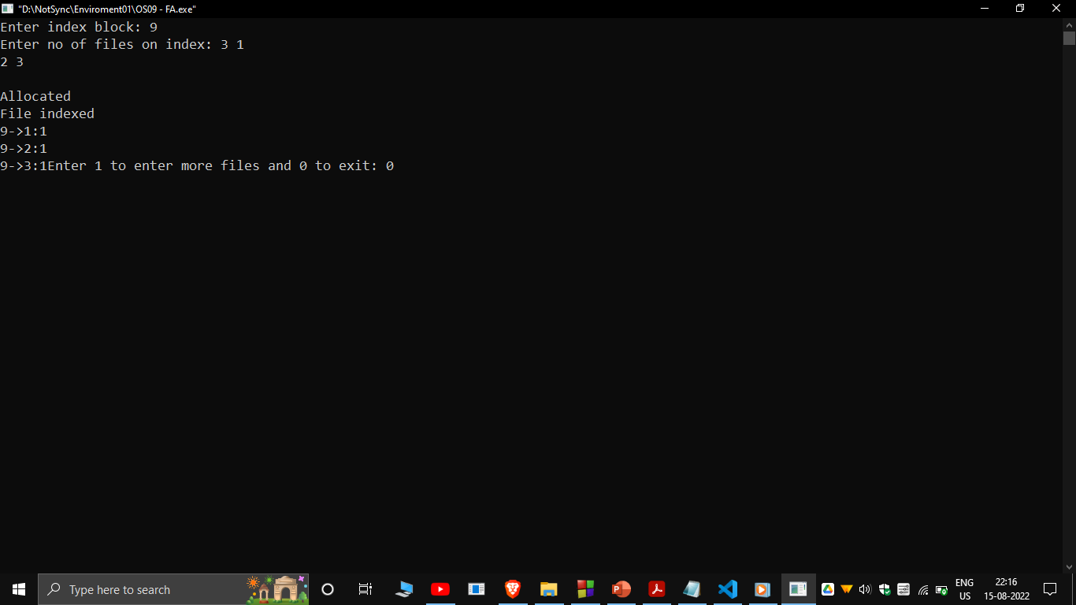
Experiment 09
File Allocation Strategies – Indexed

Slide 10
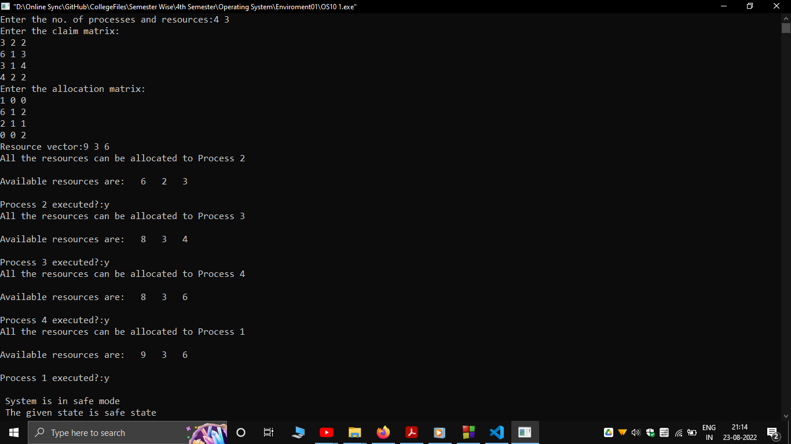
Experiment 10
Dead Lock Avoidance

